Slide 1
Darcy Flow with Adaptive Fourier Neural Operator
黃薪橙
洪仕軒 教授
Date : 2025/7/8

Slide 2
Outline
Introduction
Problem Description
Case Setup
Configuration
Loading data
Initializing the Model
Adding Data Constraints and Validators
Training the Model
Training with model parallelism
Results and Post-processing
Comparison with FNO
Demo

Slide 3
Introduction
Architecture
FNO : Relies on CNN in Fourier space.
AFNO : Inspired by Vision Transformers (ViT) principles
AFNO improvements for handling discontinuities and high-resolution :
Block-diagonal channel mixing.
Adaptive weight sharing across patches.
Sparse frequency modes via soft-thresholding.
AFNO outperforms FNO in both memory usage and computational efficiency

Slide 4
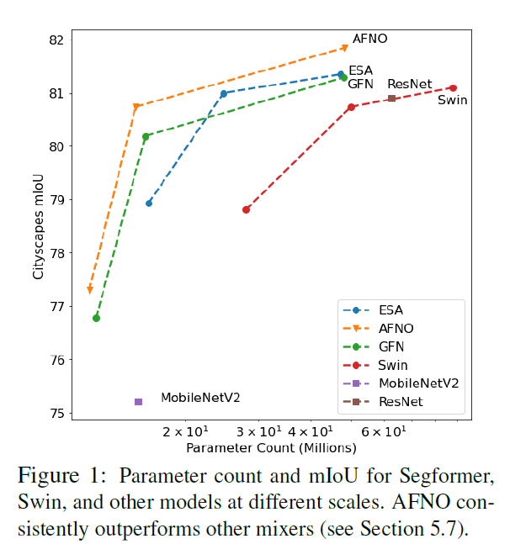
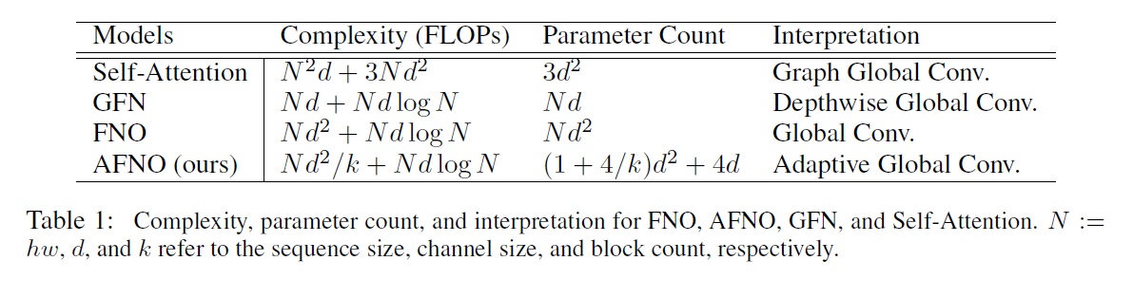
AFNO paper
Adapting FNO from PDEs to vision needs several design modifications.
(Left) AFNO has better complexity and requires fewer parameters than other methods.
(Right) AFNO consistently achieves higher mIoU with equal or fewer parameters.
[Guibas, John, et al., ICLR 2022]

Slide 5
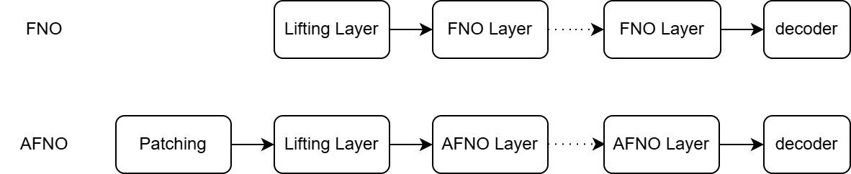
Architecture - FNO and AFNO
Patching : Divides the input image into smaller, non-overlapping sections
Lifting Layer : Transforms patched tokens into higher-dimension

Slide 6
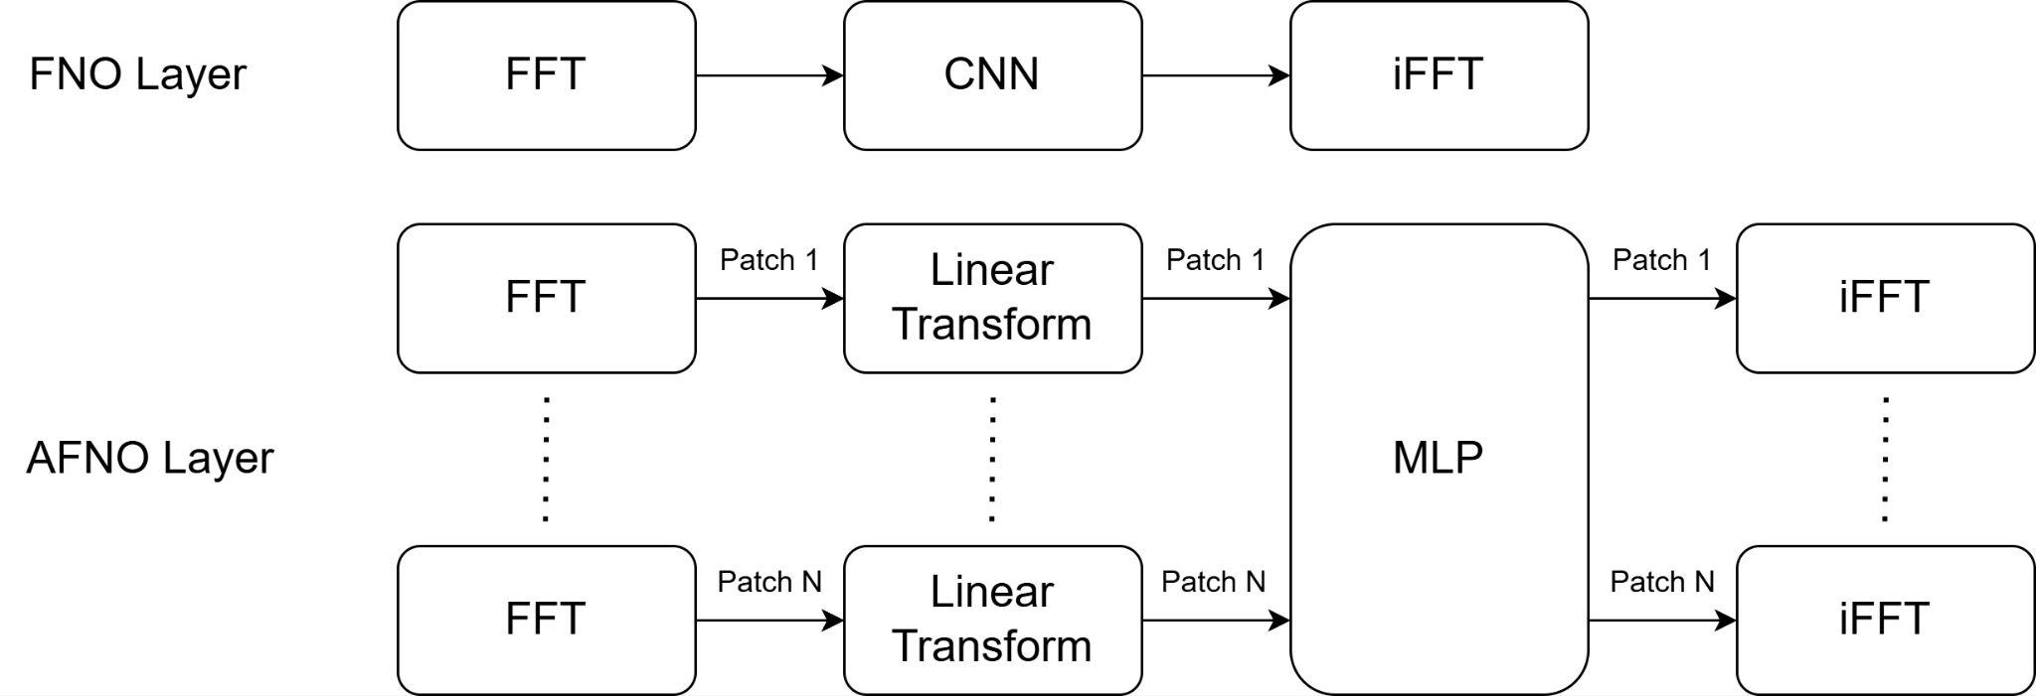
Architecture - FNO and AFNO layer
FFT : Fourier transform
iFFT : Inverse fourier transform

Slide 7
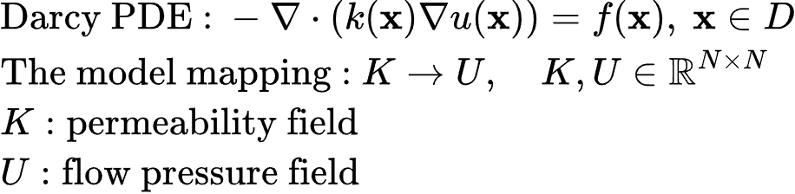
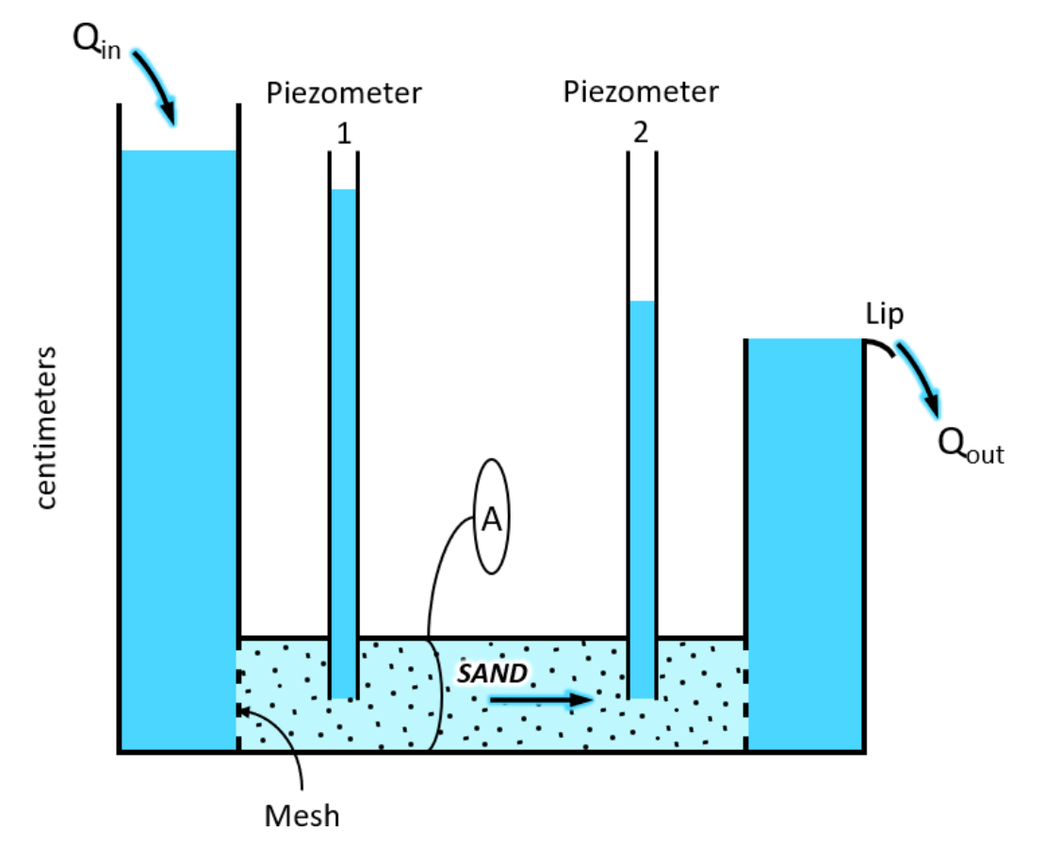
Problem Description

Slide 8
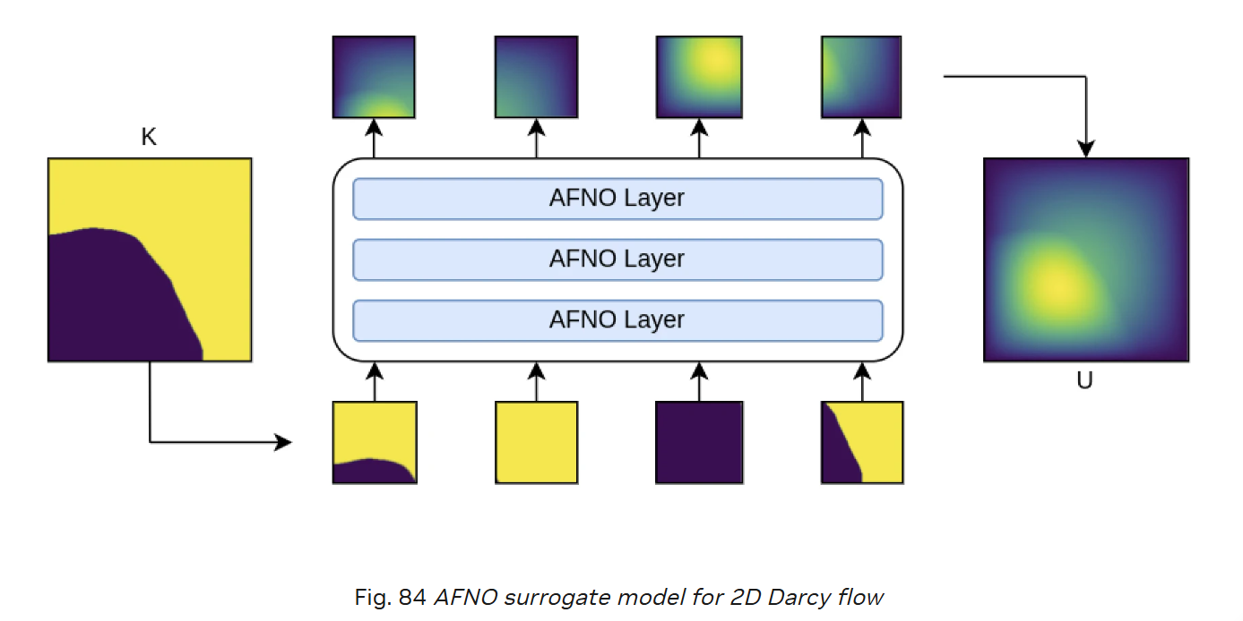
Problem Description
Input: permeability field
Output: flow pressure field

Slide 9
Case Setup

Slide 10
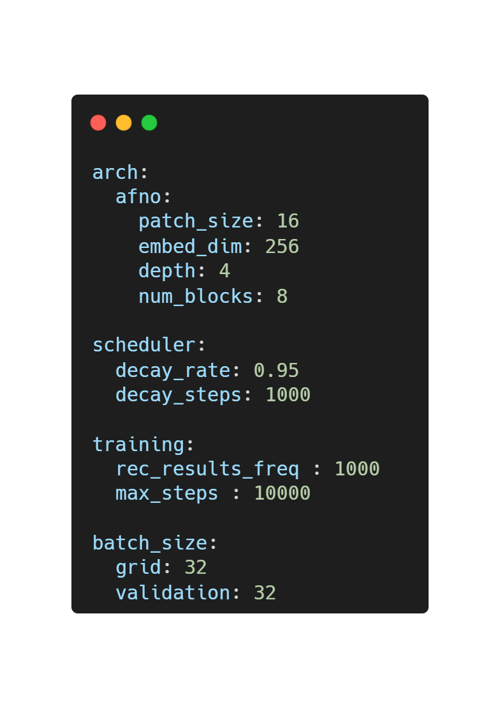
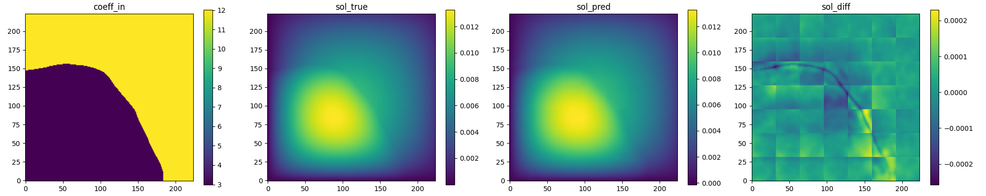
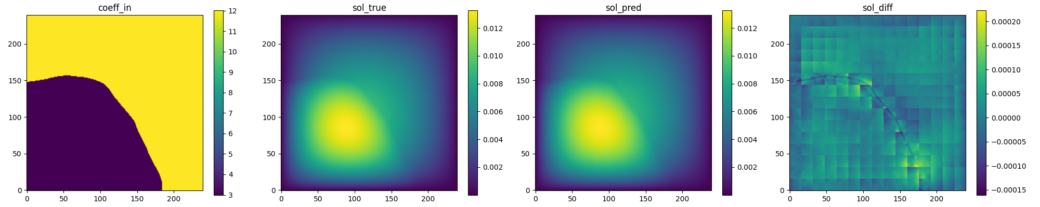
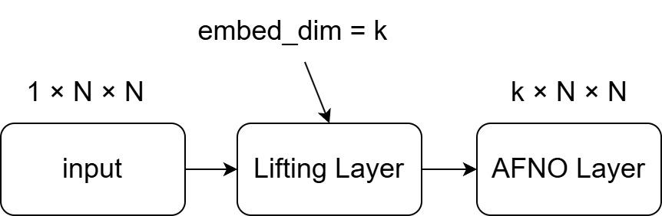
Configuration
patch size, e.g. 32, 16
config_AFNO.yaml
Size of the latent embedded features for each patch

Slide 11
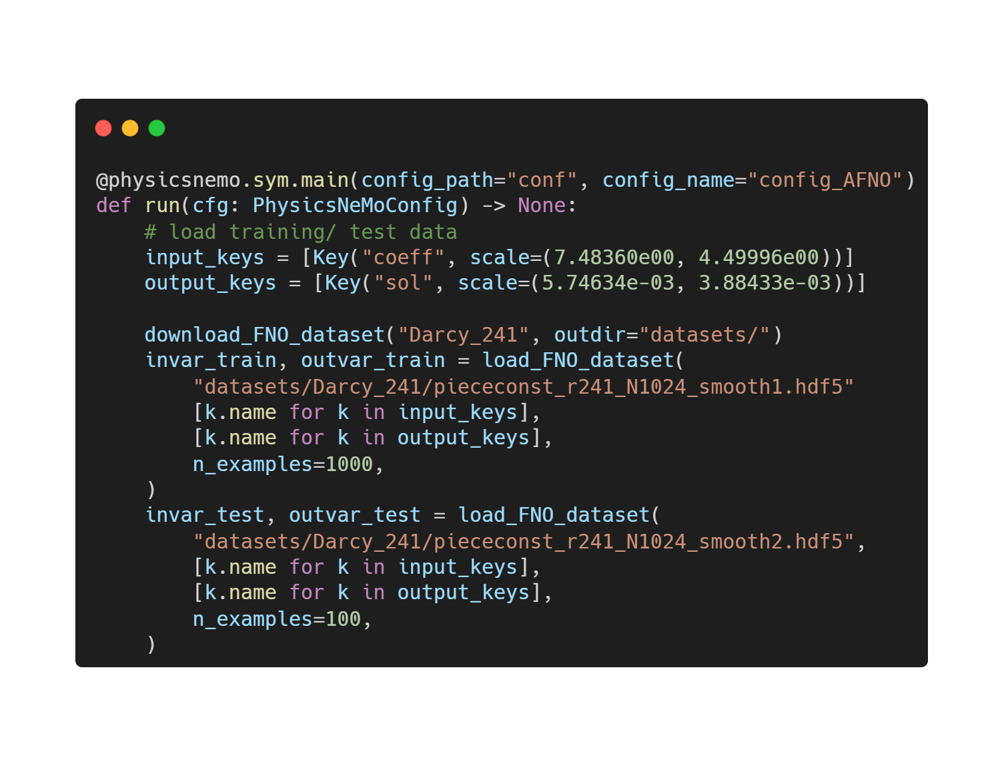
Loading data
darcy_AFNO.py
For each data includes:
coeff : Permeability Field
sol : Flow pressure Field (Ground Truth)
Total 1024 training dataset
Select 1000 training dataset
Total 1024 testing dataset
Select 100 testing dataset

Slide 12
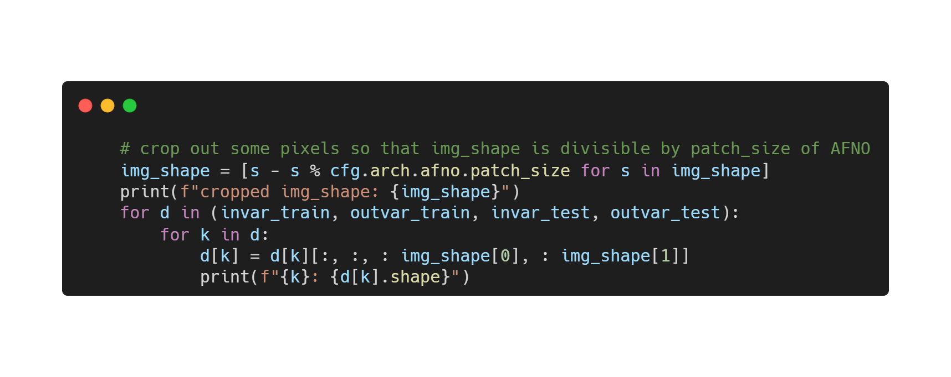
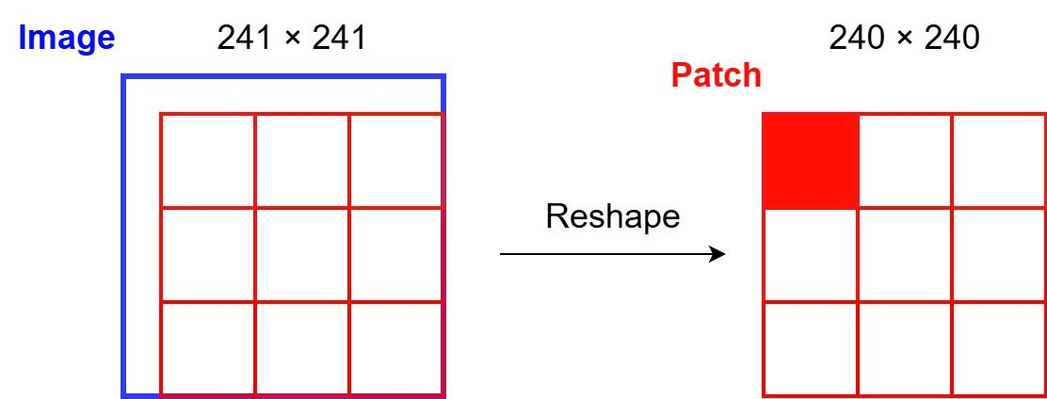
Adjust image shape

Slide 13
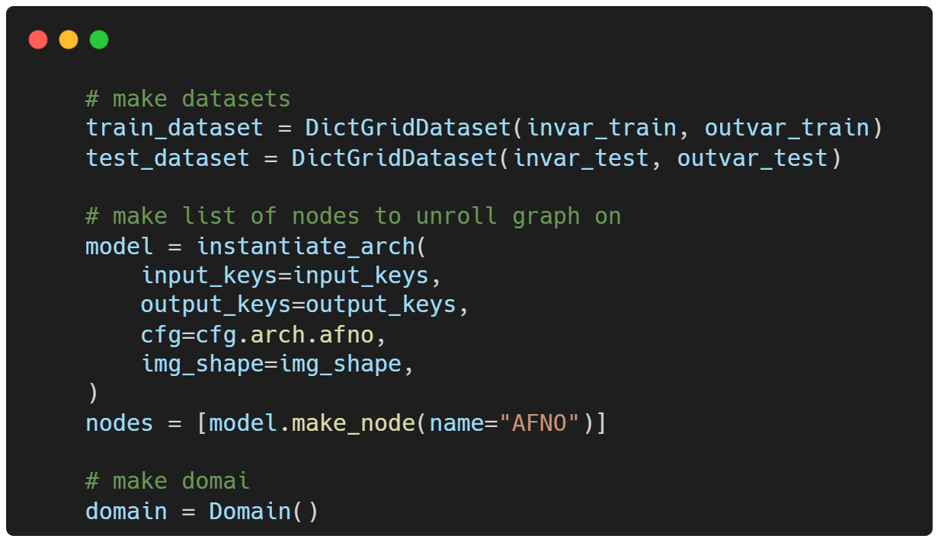
Initializing the Model

Slide 14
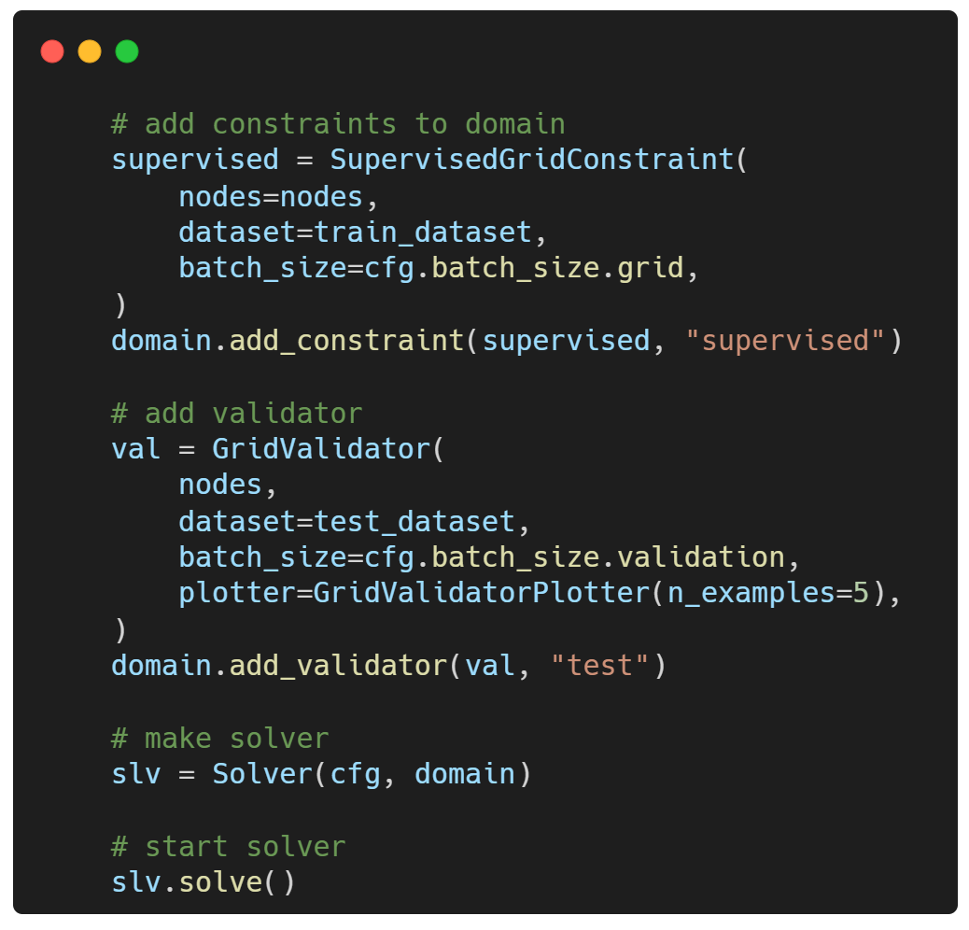
Adding Data Constraints and Validators
Computing loss with ground truth data under supervised
Generating the first 5 test samples to TensorBoard
Training the model
$ python darcy_AFNO.py

Slide 15
Training Model

Slide 16
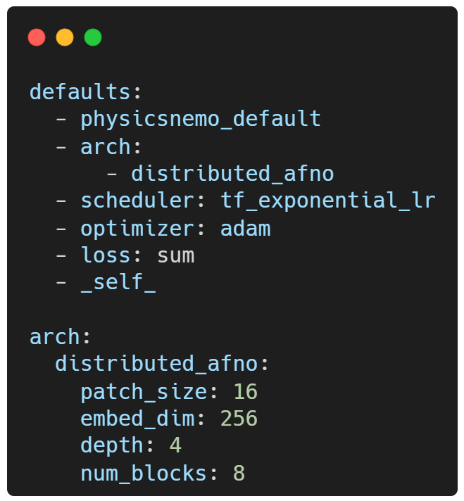
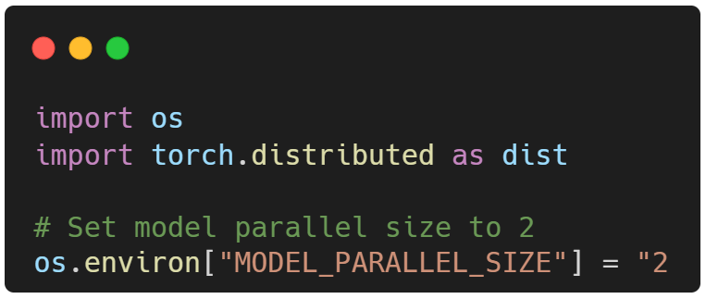
Training with model parallelism
Replace arch. with distributed_afno
in config_afno.yaml
Import required package and set environment variable in darcy_afno.py

Slide 17
Training with model parallelism
The number of GPUs to use can be changed as long as the following conditions are satisfied:
Total number of GPUs in the job must be an exact multiple of MODEL_PARALLEL_SIZE.
num_blocks must be an exact multiple of MODEL_PARALLEL_SIZE.
embed_dim must be an exact multiple of MODEL_PARALLEL_SIZE.
Training the model parallel version of the example:
$ mpirun -np 2 python darcy_AFNO_MP.py

Slide 18
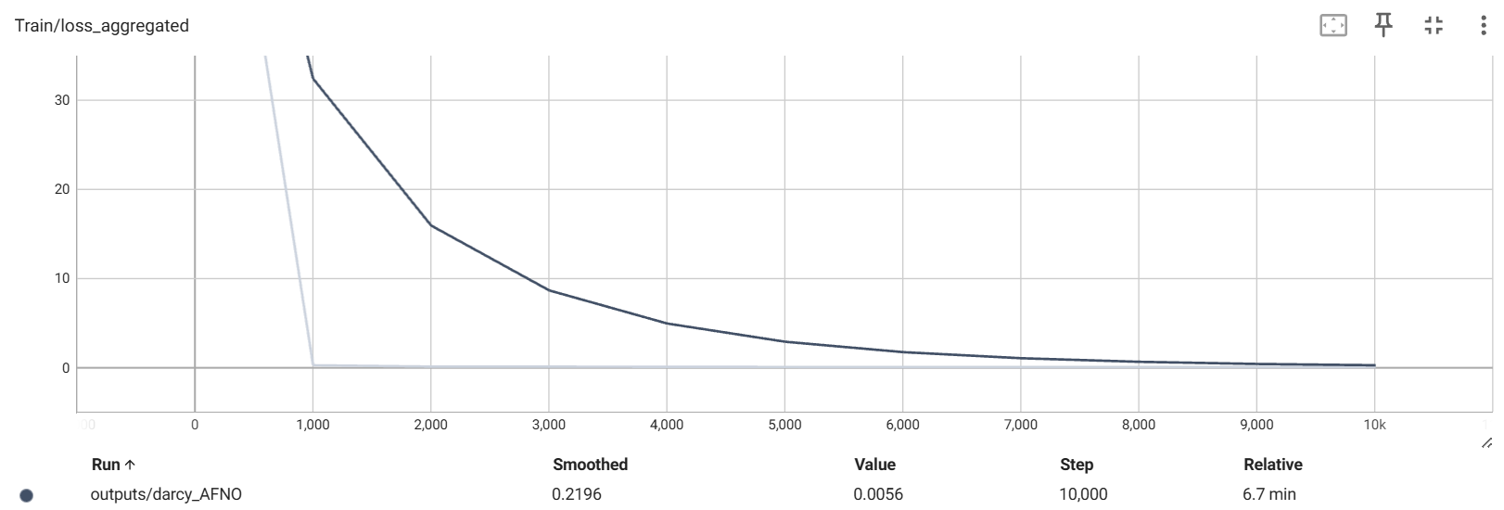
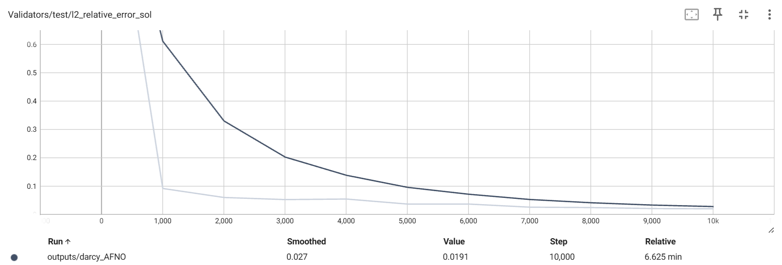
Results and Post-processing
Train/loss_aggregated
Validators/test/l2_relative_error_sol

Slide 19
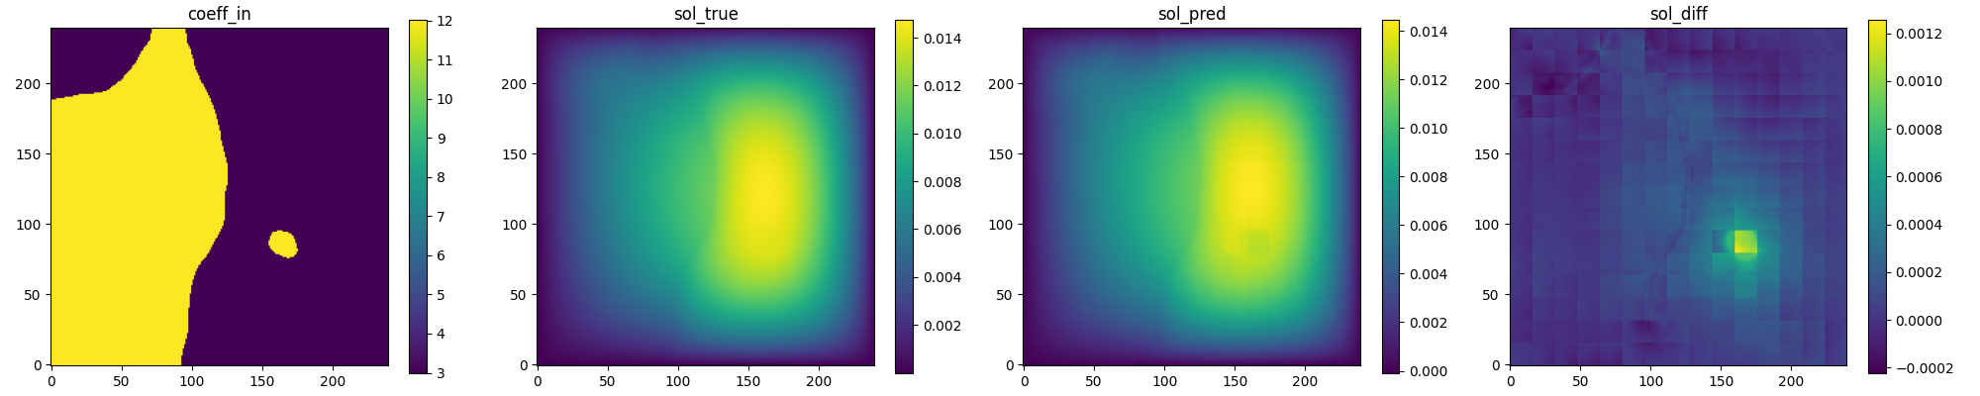
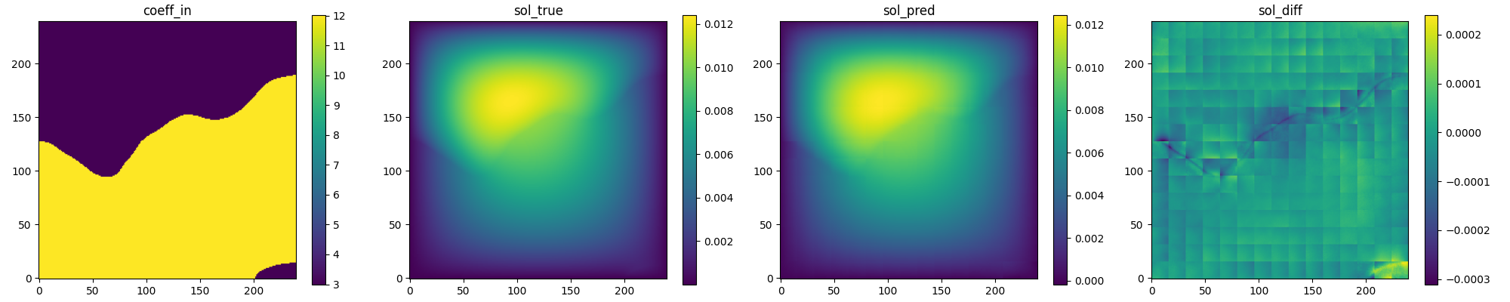
Results and Post-processing
MSE
1.0364292e-08
2.2050275e-09
2.2404723e-09

Slide 20
Comparison with FNO
Need Custom Design

Slide 21
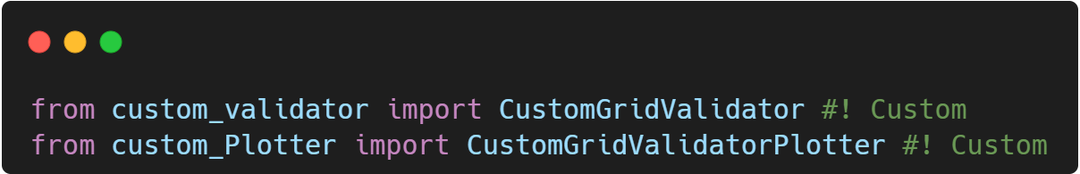
Custom function
Download code link: hello-physicsnemo-sym/darcy_AFNO
Import required package
Custom function:
Update validation test.vti
Use absolute value for loss
Set individual colorbar scale for each plot

Slide 22
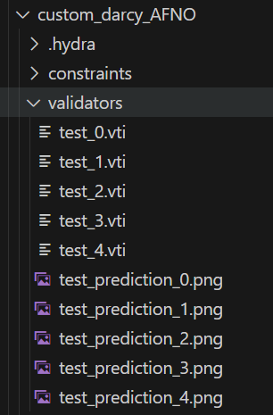
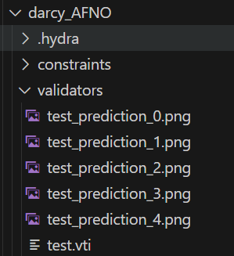
Update Validation test.vti
Default: repeat overwrite test.vti to store info.
Update: store individual validation info. with filenames like test_0.vti, test_1.vti.
Update

Slide 23
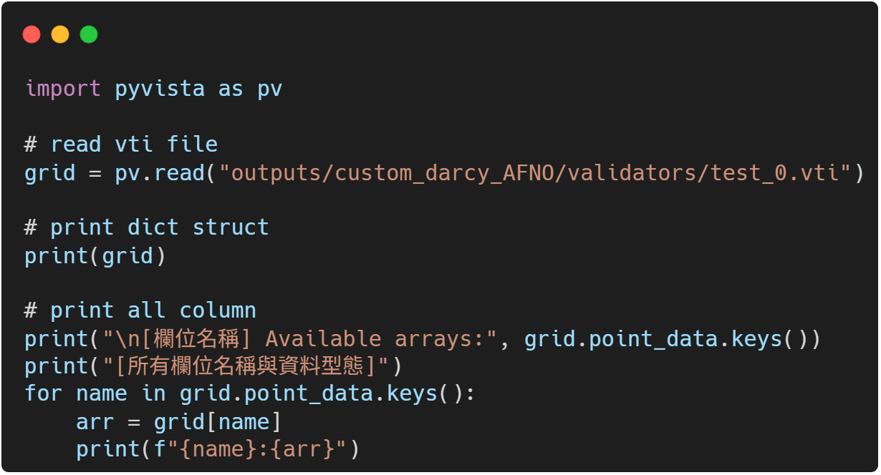
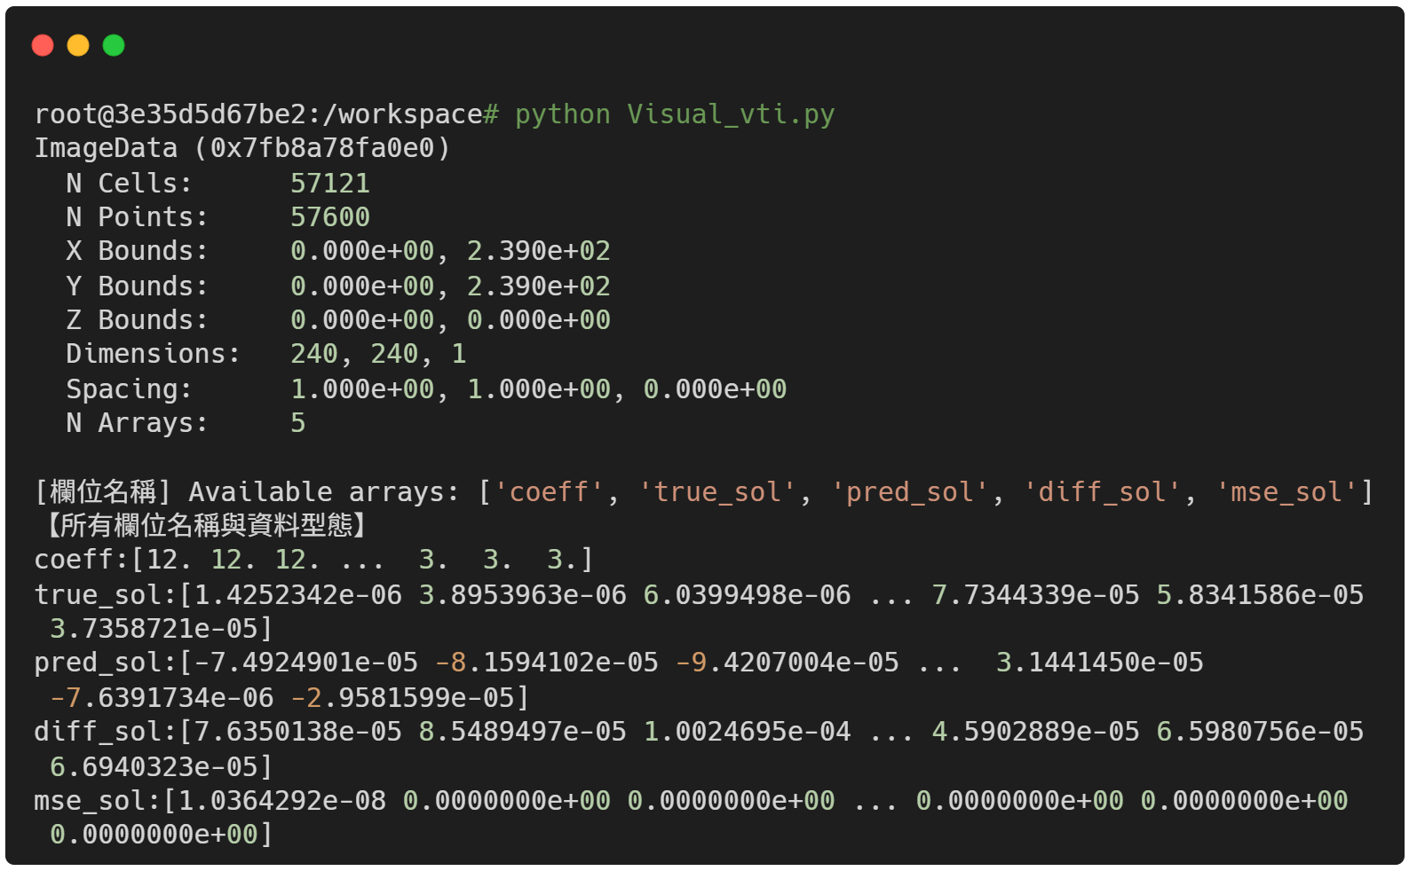
Update Validation test.vti
Using Visual.py to to read vti file
Output: coeff, true_sol, pred_sol, diff_sol, mse_sol
file path

Slide 24
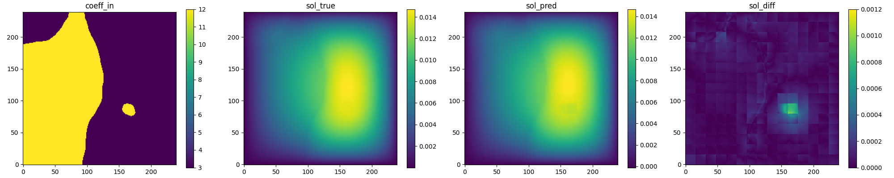
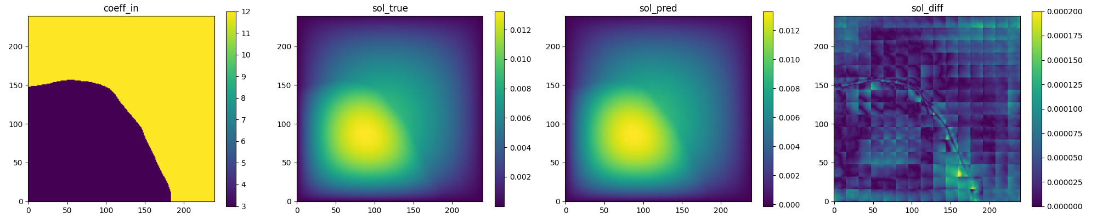
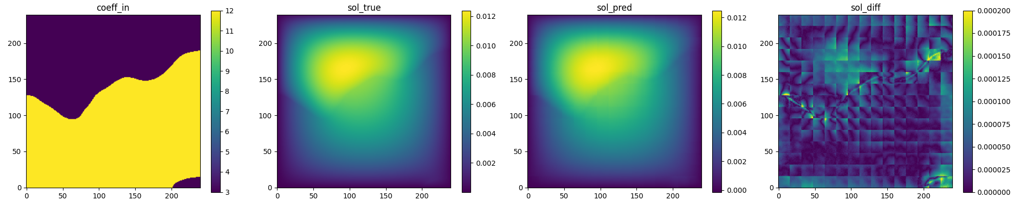
Use absolute value for loss
abs_loss

Slide 25
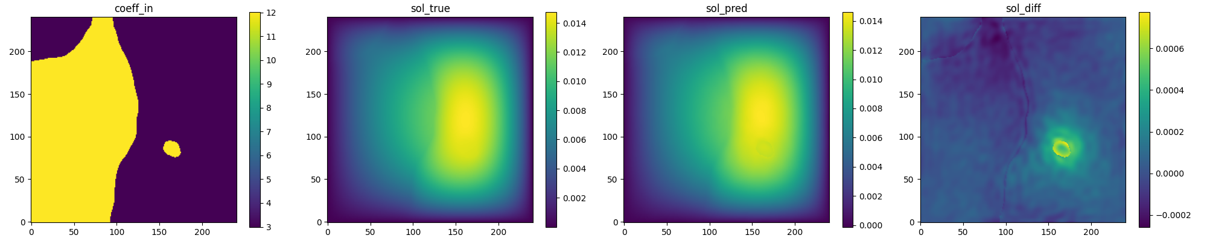
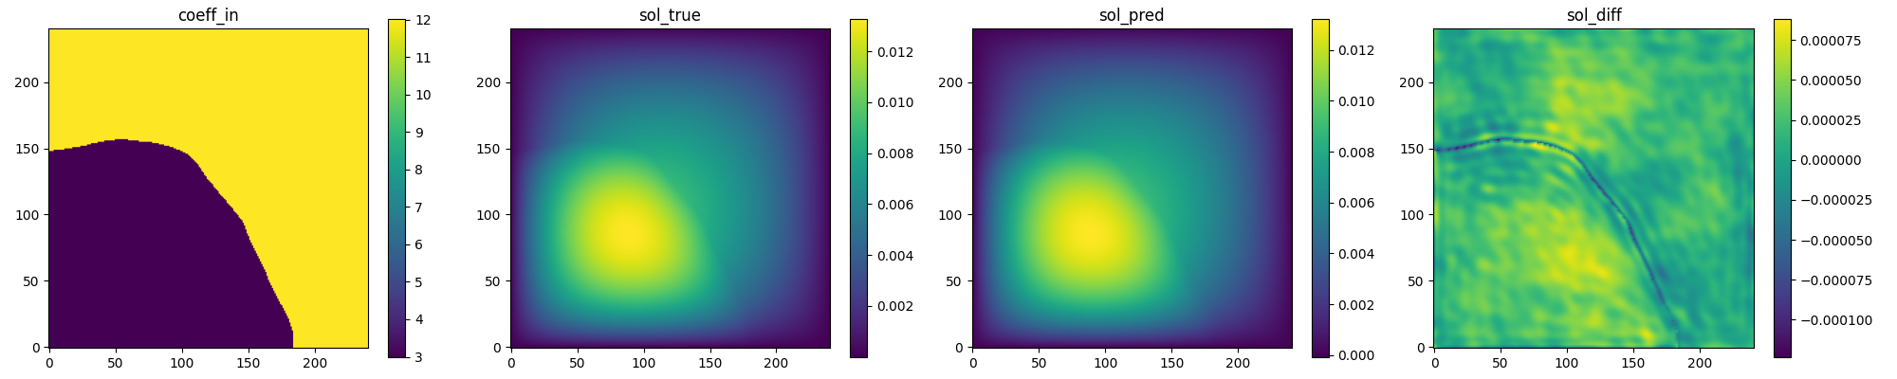
Set colorbar scale for each plot
Default: colorbar scales change automatically based on data range.
Update: Allow manual control of colorbar scale.
It is hard to compare AFNO and FNO without controlling colorbar scale.
AFNO
FNO

Slide 26
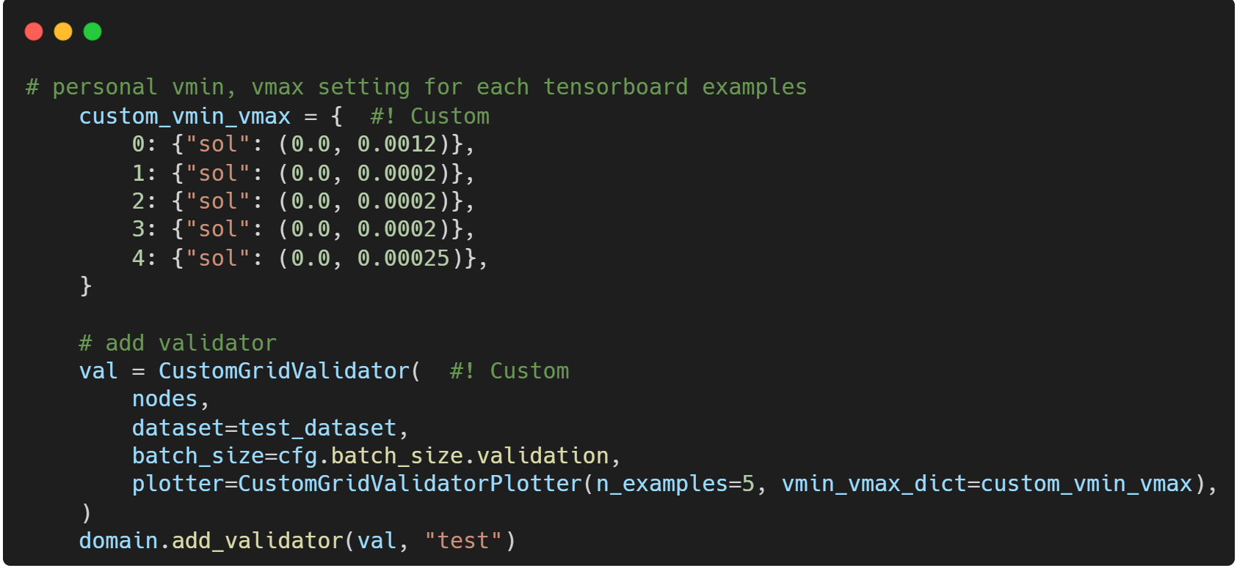
Set colorbar scale for each plot
Use customized validator plotter
Set upper and lower bound of colorbar for each sample

Slide 27
Comparison with FNO
 | custom_darcy_FNO_lazy | custom_darcy_AFNO
CPU | AMD Ryzen 9 8940HX
GPU | RTX 5070 Ti laptop
Max_step | 10000
Dataset | 1024 sample data with size 1×241×241
GPU Utilization | 94% - 96% | 50% - 56%
Time | 17 min | 7 min

Slide 28
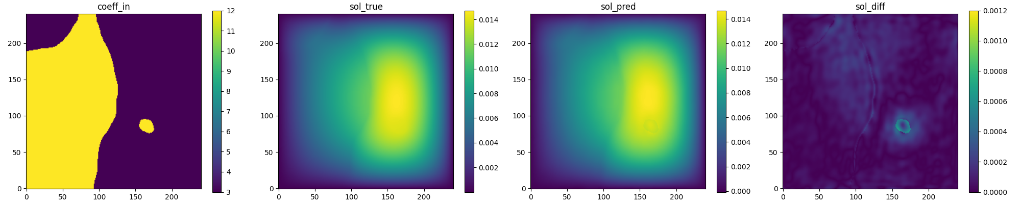
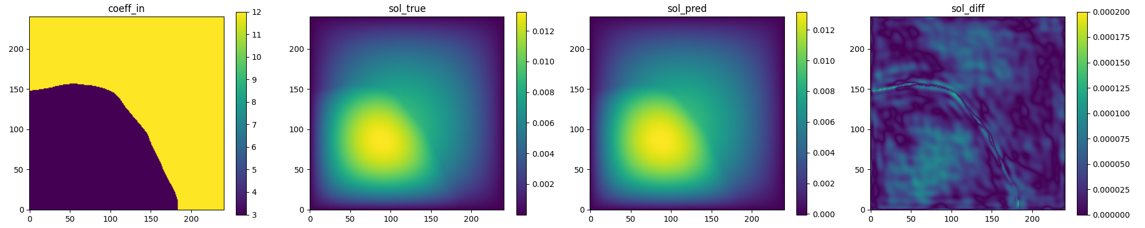
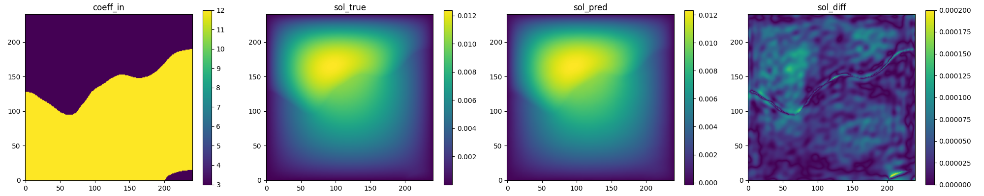
Comparison with FNO
AFNO (10000 steps)
FNO

Slide 29
Comparison with FNO
AFNO
AFNO_MSE
FNO_MSE
FNO
1.0364292e-08
8.463828e-09
2.2050275e-09
1.4134932e-09
2.2404723e-09
1.9626945e-09

Slide 30
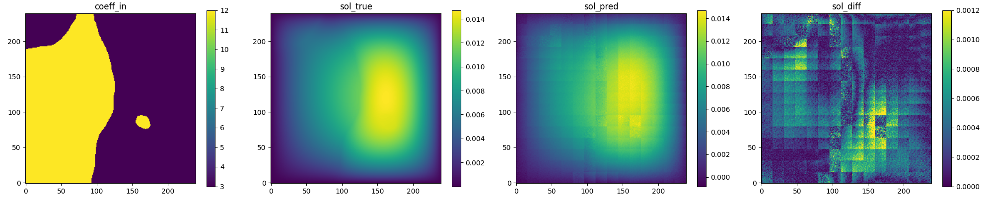
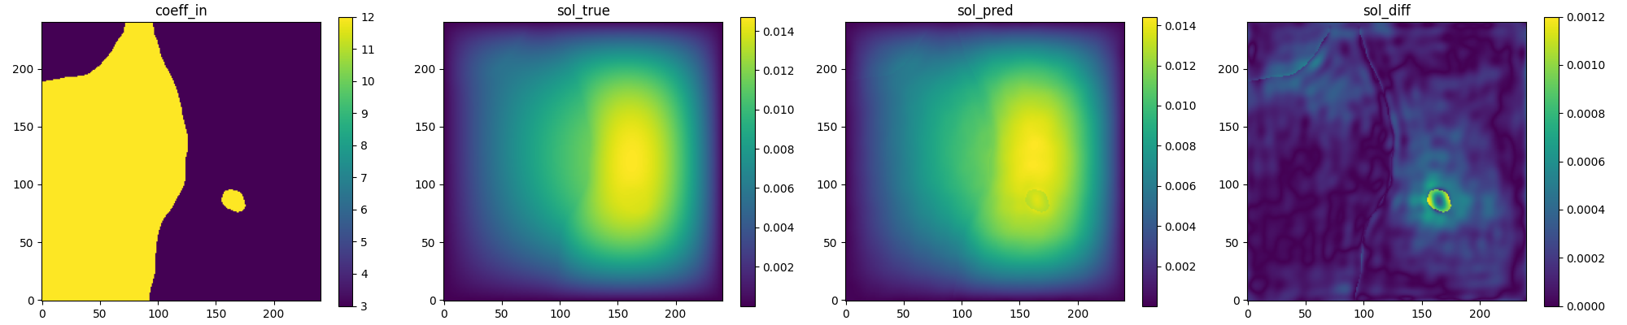
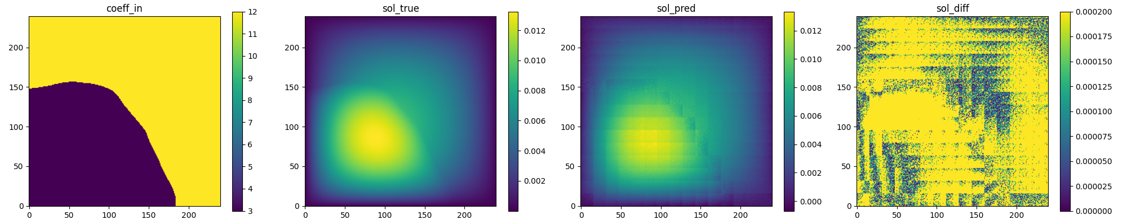
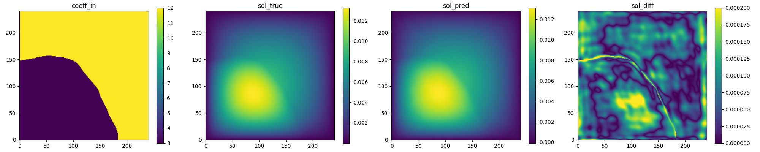
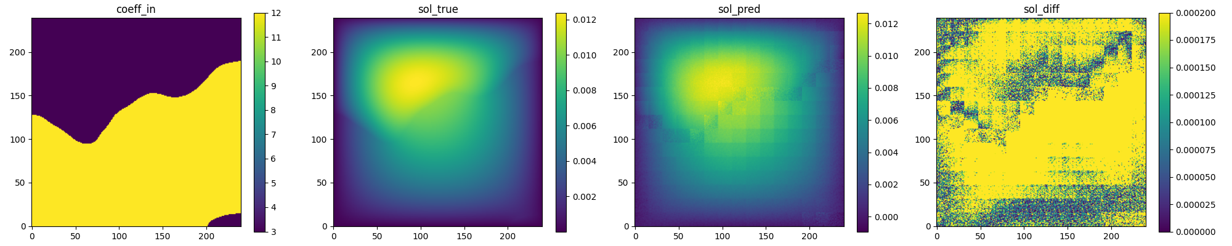
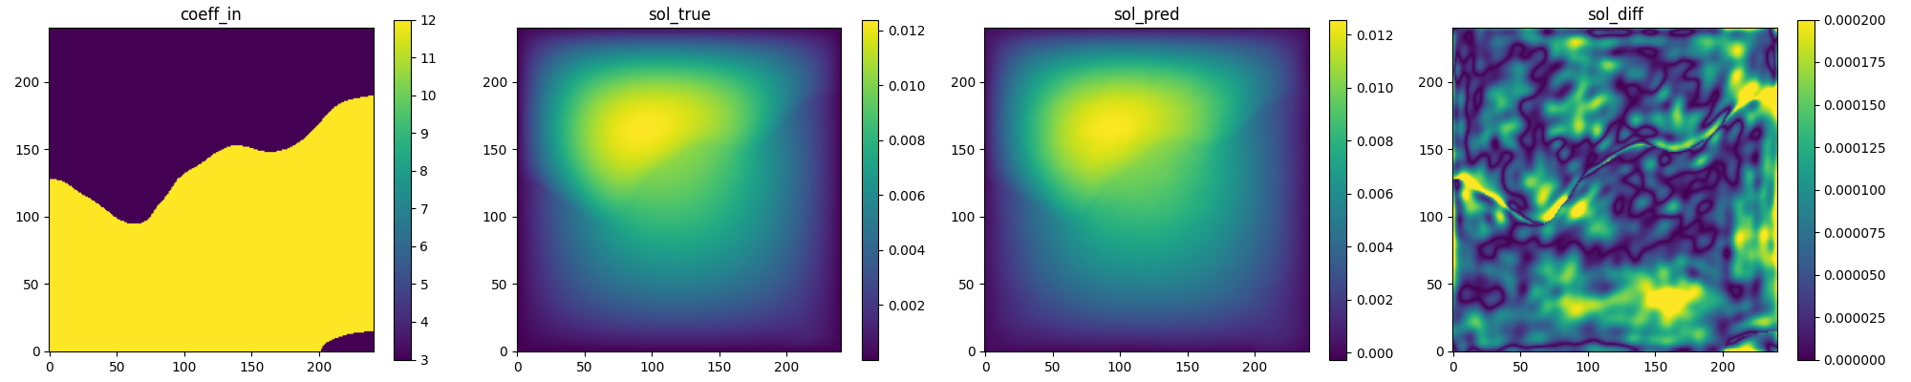
Comparison with FNO
AFNO (1000 steps)
FNO

Slide 31
Demo

Slide 32
Install physicsnemo-sym
Before starting with AFNO example, you need to install the following components:
WSL2
Docker
NVIDIA Container Toolkit
physicsnemo docker image in WSL
Download physicsnemo-sym package in WSL
$ git clone https://github.com/NVIDIA/physicsnemo-sym.git
cd to physicsnemo-sym/examples/darcy/
$ cd physicsnemo-sym/examples/darcy/

Slide 33
Launch Docker Container
Now, you are currently in the darcy file, and terminal just look like
/mnt/c/Users/User/physicsnemo-sym/examples/darcy$ …
Mount the current directory into the container's /workspace directory
$ docker run -p 7007:7007 -d --gpus all --shm-size=8g --ulimit memlock=-1 --ulimit stack=67108864 -v ${PWD}:/workspace -it nvcr.io/nvidia/physicsnemo/physicsnemo:25.03 bash
Warning : Before executing this command, your localhost 7007 port must be unused. Using this command to check if 7007 port is in use:
$ docker ps -a --format "table {{.ID}}\t{{.Names}}\t{{.Ports}}" | grep 7007
Enter container
$ docker exec -it [container_name] bash

Slide 34
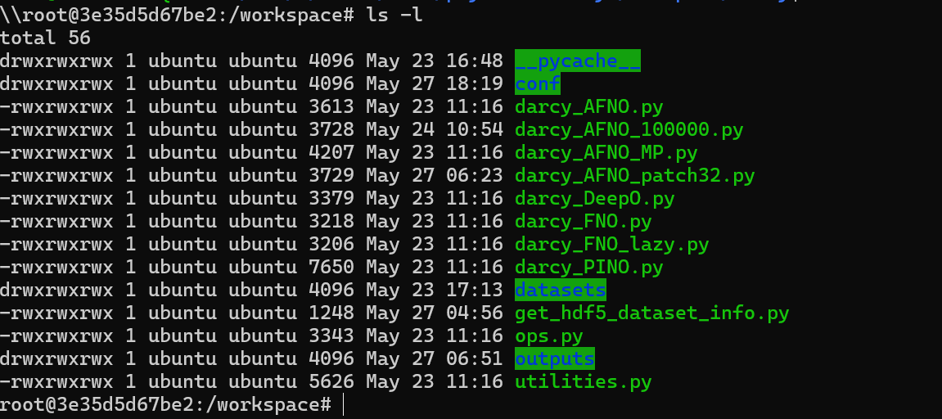
Running
View all file in /worksapce (find darcy_AFNO.py)
$ ls -l
Training
$ python darcy_AFNO.py

Slide 35
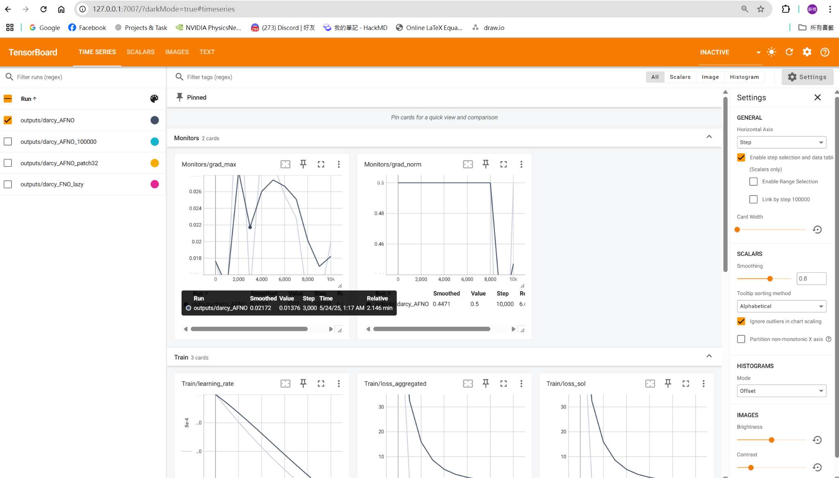
Training results
Open tensorboard
$ tensorboard --logdir=./ --port=7007
Link to 127.0.0.1:7007 on your browser

Slide 36
API
Constraint:
physicsnemo.sym.domain.constraint.discrete.SupervisedGridConstraint
Validator:
physicsnemo.sym.domain.validator.discrete.GridValidator
Hydra:
physicsnemo.sym.hydra.config.PhysicsNeMoConfig

Slide 37
API
class physicsnemo.sym.domain.constraint.discrete.SupervisedGridConstraint(nodes: List[Node], dataset: Union[Dataset, IterableDataset], loss: Loss = PointwiseLossNorm(), batch_size: int = None, shuffle: bool = True, drop_last: bool = True, num_workers: int = 0)
Data-driven grid field constraint
nodes (List[Node]) – List of PhysicsNeMo Nodes to unroll graph with.
dataset (Union[Dataset, IterableDataset]) – dataset which supplies invar and outvar examples Must be a subclass of Dataset or IterableDataset
loss (Loss, optional) – PhysicsNeMo Loss function, by default PointwiseLossNorm()
batch_size (int, optional) – Batch size used when running constraint, must be specified if Dataset used Not used if IterableDataset used
shuffle (bool, optional) – Randomly shuffle examples in dataset every epoch, by default True Not used if IterableDataset used
drop_last (bool, optional) – Drop last mini-batch if dataset not fully divisible but batch_size, by default False Not used if IterableDataset used
num_workers (int, optional) – Number of dataloader workers, by default 0

Slide 38
API
class physicsnemo.sym.domain.validator.discrete.GridValidator(nodes: List[Node], dataset: Dataset, batch_size: int = 100, plotter: GridValidatorPlotter = None, requires_grad: bool = False, num_workers: int = 0)
Data-driven grid field validator
nodes (List[Node]) – List of PhysicsNeMo Nodes to unroll graph with.
dataset (Dataset) – dataset which contains invar and true outvar examples
batch_size (int, optional) – Batch size used when running validation, by default 100
plotter (GridValidatorPlotter) – PhysicsNeMo plotter for showing results in tensorboard.
requires_grad (bool = False) – If automatic differentiation is needed for computing results.
num_workers (int, optional) – Number of dataloader workers, by default 0

Slide 39
Thank you

